Slide 1
Geostatical analysis and applications - a workshop
- 河南大学地理环境学院

Slide 2
从学院更名谈起
传统与科学的传承
地理学在现代科学中的重要性

Slide 3
地理学里面的哲学讨论
地学二元论与人地耦合关系
自然人文科学殊途(新康德流派)
人地耦合系统(NSF 2007)
吴传钧院士学术思想
地域差异研究与逻辑实证主义
Hartshorne的区域学派
逻辑实证主义与计量革命

Slide 4
地理学家的专业优势
地图学,数据可视化
地统计学与空间分析方法
空间化思维方法 Spatial thinking
自然科学和人文科学的接口
coupled nature-human system

Slide 5
GIS专业硕博士生训练目标
学
会读 (英文)
会查资料
会编程
思
Spatial thinking
逻辑性,逆向思维,发散思维,跳出框子
比较,综合,拓展
辩
会写 (英文)
会说 (英文)

Slide 6
Tobler's First law of Geography
Waldo Tobler (1970) and (2004) first stated and reinstated that there is a guiding law in spatial science that "everything is related to every else, but near things are more related than distant things".
In 2004, in a special issue of Annals of AAG, Daniel Sui led a forum to allow Michael Goodchild, Harvey Miller, Waldo Tobler, and other geographers to have a debate of this issue

Slide 7
Two important concepts
Spatial autocorrelation
What is it?
How to measure it?
How to use it?
Spatial heterogeneity
What is it?
How to measure it?
How to use it?

Slide 8
Distance defined in space
Euclidean distance - straight line distance between any two points
Cost surface distance - distance of traveling in the mountainous area
Distance along a channel
Distance in a city- road network distance
Distance between polygons

Slide 9
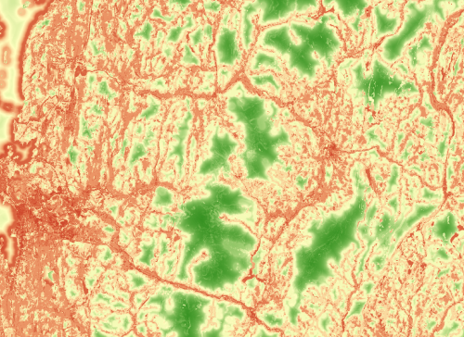
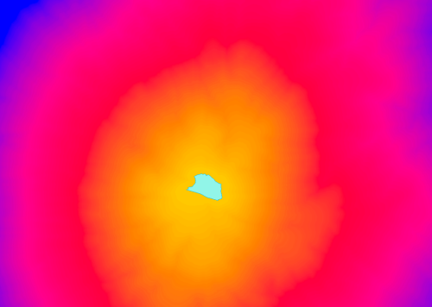
Cost surface distance
Source: ESRI understanding cost distance

Slide 10
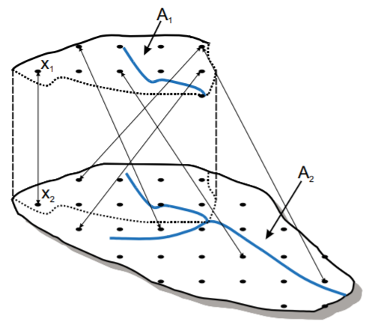
Distance between watersheds
A schema of watershed distance in topkriging
J. O. Skøien, R. Merz, and G. Blöschl, “Top-kriging - geostatistics on stream networks,” Hydrol. Earth Syst. Sci., vol. 10, no. 2, pp. 277–287, Apr. 2006, Accessed: Dec. 14, 2020. [Online].

Slide 11
Manhattan distance in an urban area

Slide 12
Channel distance

Slide 13
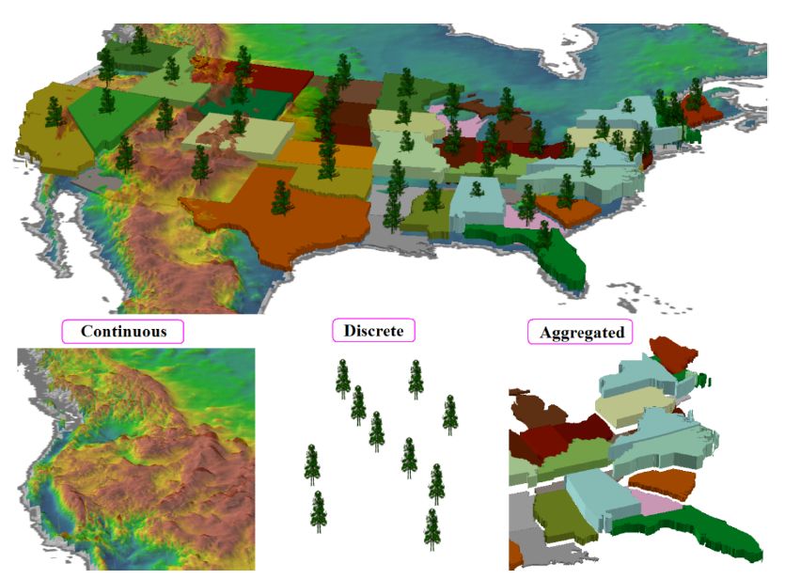
Spatial data types
Discrete - point pattern analysis
Continuous - geostatistics
Regional - lattice analysis

Slide 14
Stationarity of the geostatistical models
Stationarity - Data have similar statistical properties in any part of the study area
First-order stationarity - mean of the variable is the same everywhere
Second-order stationarity - variance of the variable is the same everywhere
Moran's I assumes the mean and variance are constants
Spatial correlation between any two locations is only dependent on the orientation and magnitude (distance) of the vector separating the two locations
Data that do not follow such assumptions: disease rate (incidence per 1000 person) has variance depending on the population.
Data transformation can alter data to fit the assumptions.

Slide 15
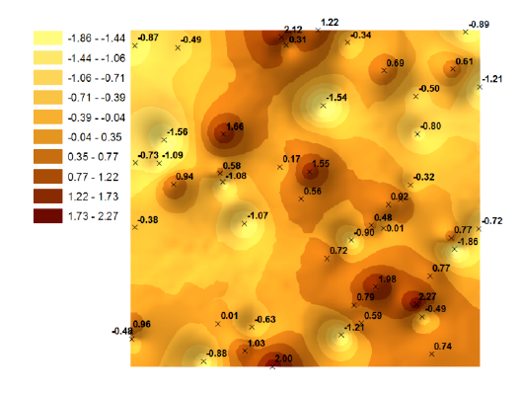
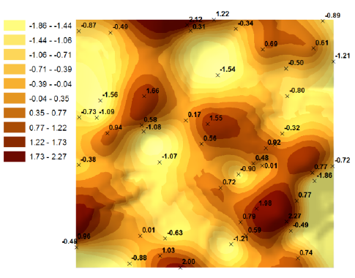
Two deterministic interpolation models
IDW
Minimum curvature spline

Slide 16
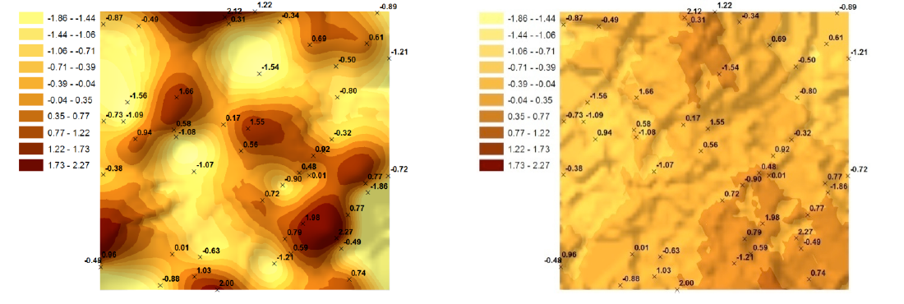
Kriging vs. IDW

Slide 17
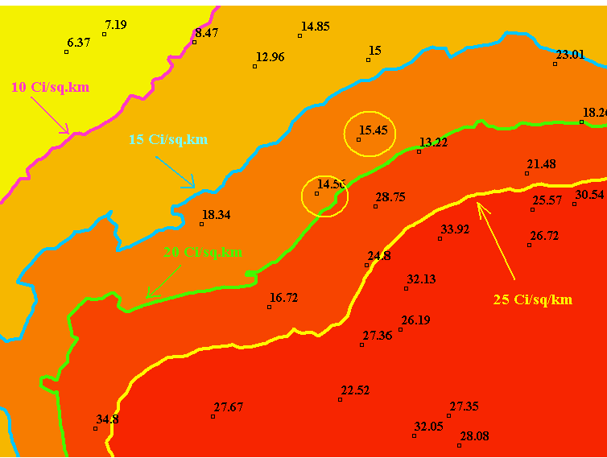
Importance of uncertainty
Chernobyl accident in 1986, quick decision about evacuate.
Maximum permissible exposure was 1 millisievert per year
Soil samples measured with radiocesium contamination in unit of curies/km^2. The upper limit is 15 ci/km2. Question: which areas are possibly over the upper limit?
Kriging interpolation gives the range of the two sites: 14.2-19.9 and 13.8-20.0. They are unsafe.

Slide 18
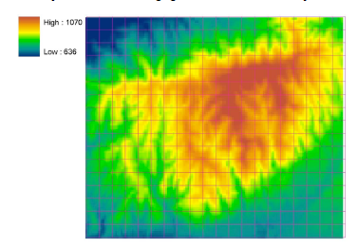
Uncertainty in GIS data
Consider a scenario of data aggregation
An DEM is resampled from 119 by 139 to 17 by 20 cells using zonal statistics in ArcGIS

Slide 19
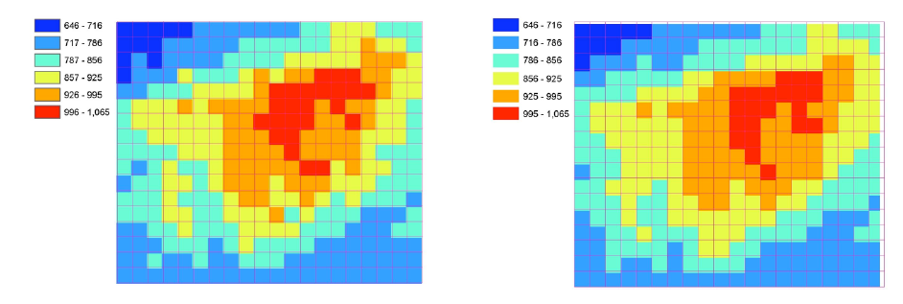
Using arithmetical mean or block kriging?
Do they look the same?

Slide 20
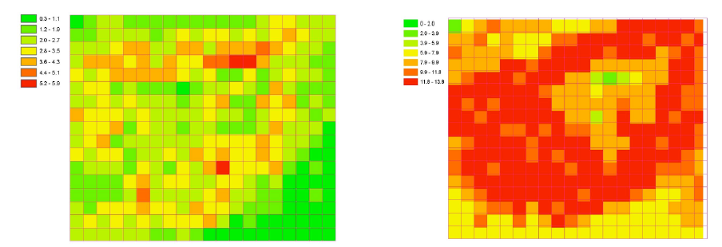
What about uncertainty estimated from the two models?
Using arithmetic averaging is simple and gives small uncertainty. No, it actually underestimated the averaging accuracy for the spatially correlated data

Slide 21
Inference of data uncertainty
Measure of data uncertainty with the predicted values affect the conclusions drawn from the map.
If the predicted elevation is 850 m and the uncertainty is ± 5 m, the decision made will be very different from the prediction with the same value 850m but with an uncertainty of ± 35 m.
People should always prepare for the worst scenarios based on prediction models.

Slide 22
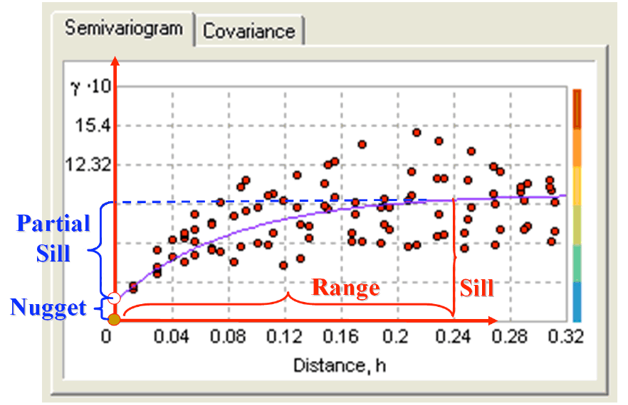
Semi-variograph technique
Semi-variogram function ϒ(h) is a measure of spatial dependence between sample points
The three parameters of a semi-variogram function: sill, nugget, range
γ(si,sj) = ½ var(Z(si) - Z(sj))
C(si, sj) = cov(Z(si), Z(sj)),
γ(si, sj) = sill - C(si, sj),

Slide 23
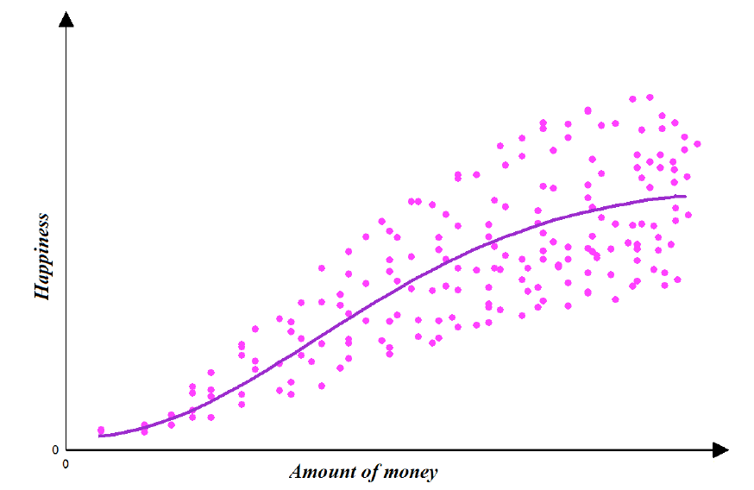
Variograph of Happiness and Money

Slide 24
Parameters of semi-variogram function
A nugget is the semi-variance at h=0. It is the measure of measurement error and the data variability at fine scales (microstructure)
The sill is the point where the variogram levels off; background noise; where there is little autocorrelation
The range is the lag distance at which the sill is reached. Beyond this distance, the data do not have significant statistical dependence
The partial sill = (Sill - Nugget ) is the amount of variation in the process that generated the data

Slide 25
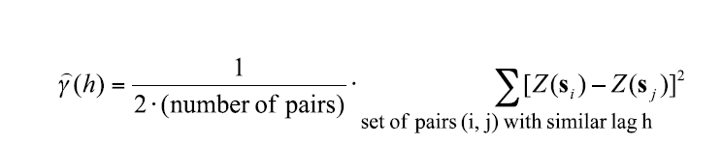
Computing r(h)

Slide 26
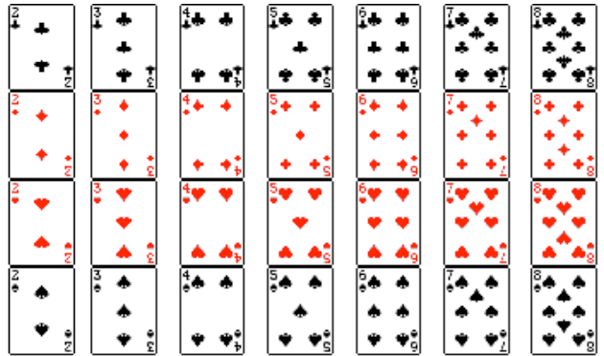
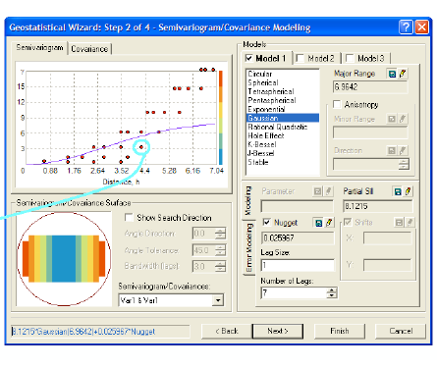
Variogram of cards

Slide 27
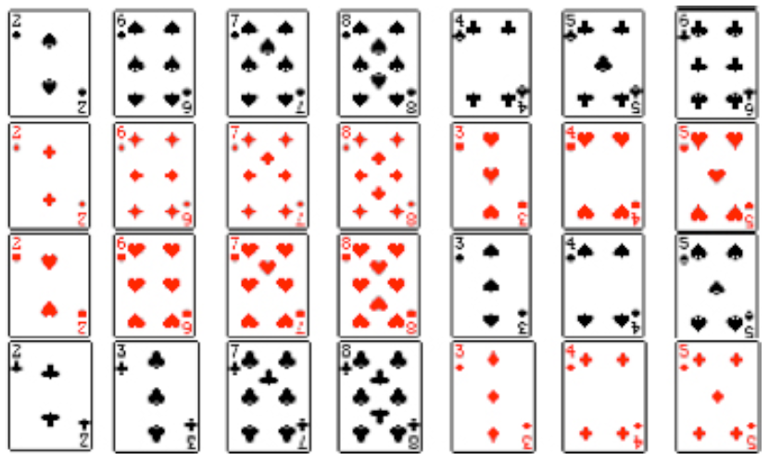
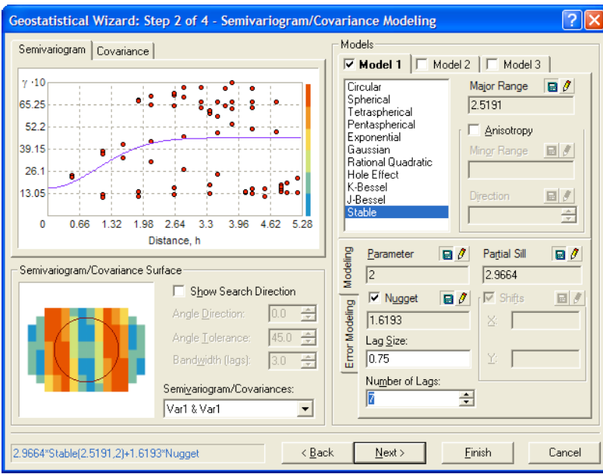
Shuffling cards

Slide 28
Lab exercise
https://github.com/leiwanglsu/kriging_workshop.git

